Slide 1
Rightsizing
Notes:
NEXT: What is Rightsizing? It should be pretty obvious? Let’s have a look..
[click]

Slide 2
Rightsizing
Key Terms
Identify and fix issues with oversized and undersized VMs.
Based on Aria Operations Recommendations!
Configure Policies for
Criticality Thresholds
Risk Level (Conservative vs. Aggressive)
Business Hours
Automate Rightsizing
Notes:
A proactive practice. Not a one-time work
Maximizes performance efficiency
Reduces costs Ensures seamless alignment with requirements

Slide 3
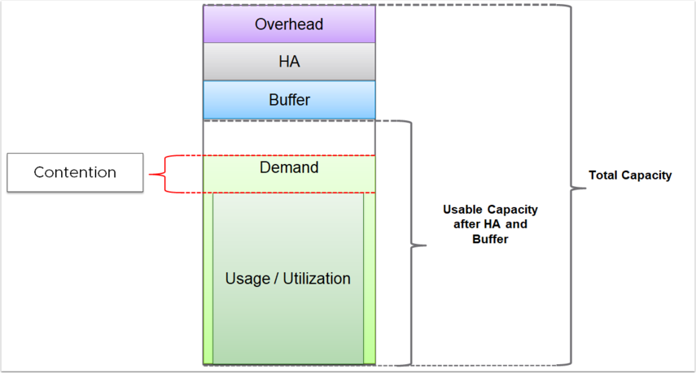
Rightsizing
Understanding the capacity settings
Notes:
Definitions
Total Capacity: All available resources (CPU, memory, disk space, IOPS) in the environment.
Usage: Resources presently utilized by VMs and system services.
Demand: Resources needed by VMs; equals usage unless a resource is constrained.
Usable Capacity: Total capacity minus a buffer set aside for workload spikes.
Usable Capacity after HA and Buffer: Usable capacity less resources reserved for HA failover.

Slide 4
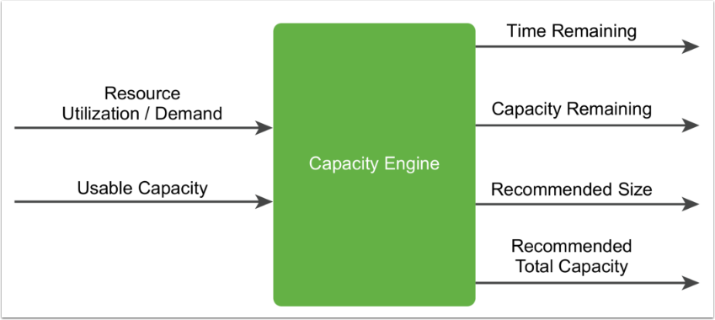
Rightsizing
Understanding the capacity settings
Notes:
Capacity engine analyzes historical utilization and projects future workload
Using real-time predictive capacity analytics
#INPUT: Demand + Usable Capacity metrics,
#GENERATED OUTPUT:
Time Remaining (estimated time before full utilization)
Capacity Remaining (available capacity)
Recommended Size (optimal resource configuration)
Recommended Total Capacity (required future capacity)
# Recommended size
Determined by projecting utilization for a specific period. It extends 30 days beyond the warning threshold, which is the green period for time remaining. The recommended size does not include HA settings. By default, if the warning threshold is set at 120 days, the recommended size reflects the maximum projected utilization 150 days ahead. To maintain conservative recommendations, VMware Aria Operations imposes caps on the recommended size generated by the capacity engine.
*) Oversized: Aria Operations limits oversized recommendations to 50% of the current allocation. For instance, if a virtual machine with 8 vCPUs #historically only used up to 10% CPU, the recommendation is capped at reclaiming 4 vCPUs rather than 7.
*) Undersized: Aria Operations limits undersized recommendations to 100% of the current allocation. For example, if a virtual machine with 4 vCPUs consistently experiences high resource utilization, the recommendation is capped at adding 4 vCPUs instead of suggesting 8.

Slide 5
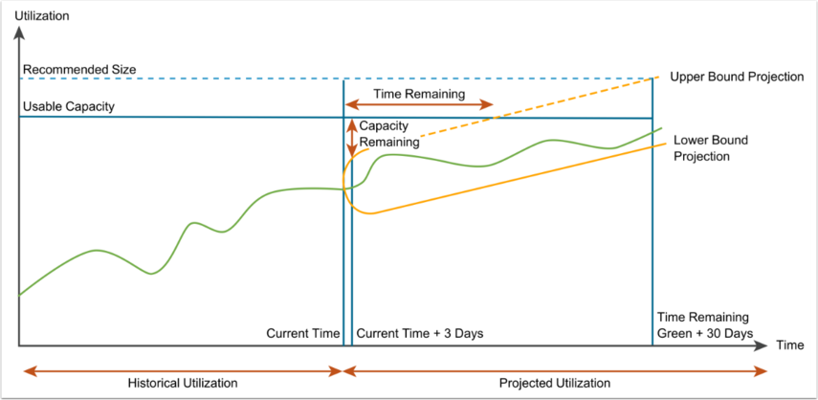
Rightsizing
PROJECTION, CONSERVATIVE RISK LEVEL
Notes:
Capacity calculations for a Conservative Risk Level
Customize the level of conservatism
Prioritize stability
Ensure enough resources for future growth and demand.
A cautious approach to capacity planning
Lower consolidation ratios + higher resource overhead

Slide 6
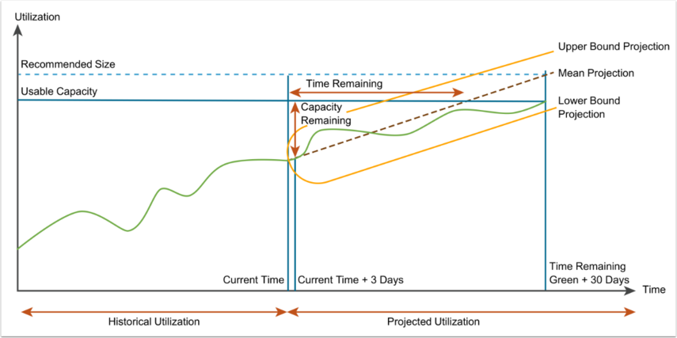
Rightsizing
PROJECTION, Aggressive Risk Level:
Notes:
Aim to maximize resource utilization and minimize overhead.
Assumes a higher tolerance for risk
Allows for more aggressive allocation of resources.
Result: Higher consolidation ratios + tighter resource utilization.

Slide 7
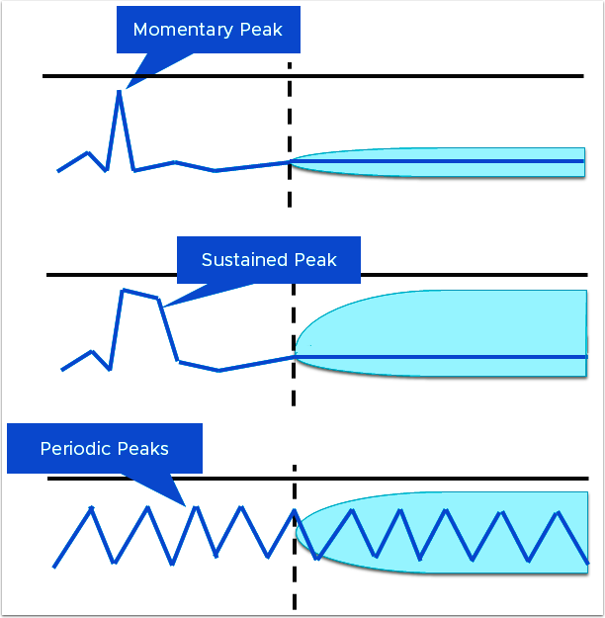
Rightsizing
Utilization PEAKS
Notes:
Momentary Peaks: Short-lived peaks that are a one-time occurrence. Not significant enough to require additional capacity.
Sustained Peaks: Last for a longer time and impact projections.
Periodic Peaks: Cyclical patterns or waves. (hourly, daily, weekly, monthly, last day of the month, etc)

Slide 8

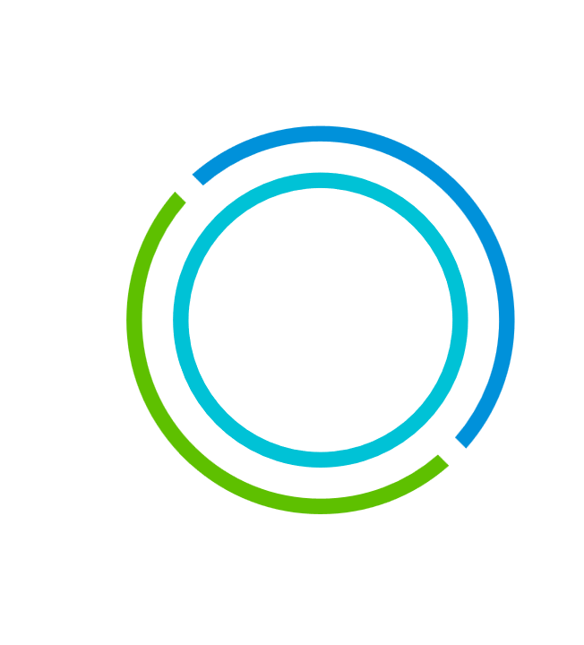

Learn More at Tech Zone
Modern Apps and Cloud Management Tech Zone
Go from zero to hero with the latest technical resources.
Learn more about Aria products using the Customer Journey.
Visit: https://apps-cloudmgmt.techzone.vmware.com/vmware-aria-cloud-management

